Slide 1
james the GIANT killer: evaluating locking schemes in
2010-02-27
james francis toy iv
David Hemmendinger

Slide 2
Purpose
Evaluate current locking scheme in FreeBSD
See if the locking methods can be improved
Evaluate both methods and form conclusions

Slide 3
WAIT! why do we need locking?
Race conditions
“bad” “dog”
Threads race each other on context switches
Possible incorrect result : “bda dog” (interleaving)
Alternative correct result: “dog” “bad”
Notes:
Get on with it!

Slide 4
when it matters
The most important things is correct results
Incorrect code on kernel level (close to the metal) can result in other userland applications yielding incorrect results.
In some cases incorrect code can lead to death
Therac:
typing command sequences so fast input data was being corrupted – resulted in overexposure to radiation.

Slide 5
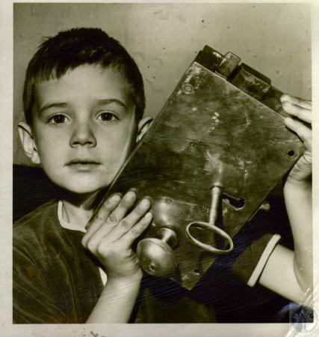
OK; so what is a GIANT_LOCK?
What the kernel currently uses for locking!

Slide 6
GIANT_LOCK
GIANT_LOCKs only allow one thread in the kernel at a time
This is the simple solution; however, it inhibits concurrency!
Why concurrency is important with Symmetric Multi-Processing
Logical concurrency w/o SMP
Is there a better solution?
kernel log
sysctl
virtual mem
scheduler

Slide 7
Fine Grained Locking (FGL)
Locks only go around shared data structures : “critical sections” in subsystems
Seldom do threads bombard a specific subsystem (kernel design issue)
Developer communities currently always favor FGL implementation
If everything is FGL then concurrency is promoted from the smallest subsystem to the largest
sysctl
kernel log
sched
mem
Notes:
If these locks are properly implemented threads are unable to be in the critical section at the same time

Slide 8
GIANT_LOCK vs. FGL
GIANT_LOCK is safe!
Guarantees no race and no deadlocks
Problem: Inhibits concurrency!
Fine grained locking promotes concurrency
Problem: Complexity?
Possible Problem: Deadlocks? (subsystems mutually exclusive)
Possible problem: locking overhead (how long FGL takes)
Will this pay off?
May depend on the subsystem
Will the FGL code present a maintenance problem?
Notes:
Is there a point where FGL is no longer more efficient?

Slide 9
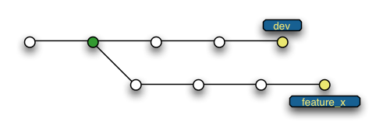
DESIGN: locking in BSD land
Tools of the trade (sleep locks, read locks, read write locks)
Two separate branches in a version control system
Specific subsystems being targeted and why
Klog
prints kernel events -- low traffic
Sysctl
manages kernel variables -- higher traffic
GIANT_LOCK
Fine Grained Locking
Notes:
Locks already in FreeBSD
Developed a new version of the kernel leaving the old one in tact

Slide 10
DESIGN: method of evaluation (comparison of FGL and GIANT)
(control)
Tests designed to hit specific subsystems (FGL a win?)
multi-threaded make sysctl
Kernel event character device klog
(locking profiler)
Set sysctl variable
Running thread(s)
Unset sysctl variable
TOO MUCH data
Notes:
= We are evaluating FGL vs. GIANT_LOCK
= DISCUSS LOCKING PROFILER already in BSD

Slide 11
Correctness and how I achieved it
Correctness
Race conditions arise from writing to a shared resource
Readers share a lock
Writers pick up exclusive lock
Process
New branch of code
Replace GIANT entry with fine grained locks
Rebuild kernels in both configurations
cron runs build test scripts (automated builds and profiling)

Slide 12
RESULTS : SYSCTL tests
μS
kernel builds with 128 threads

Slide 13
Conclusions
Sysctl did produce data that strongly support the initial hypothesis.
1/2% system increase of throughput (one small step)
Max time saved ~30 seconds (2 hrs build)
Klog test did not produce useful data because the locking mechanisms are around a device node not a msg_buffer.
Extending FGLs to more subsystems means more throughput.
Notes:
Don’t say fundamental flaw – I was mistaken from what I learned from this
One small step for man one giant leap for mankind

Slide 14
:: what really matters ::
Goal was to determine if:
FGL is detrimental to the system (complication)
FGL is significantly faster than GIANT_LOCKING in a small subsystem like sysctl.
Locking methods are a very important to SMP
Running as close to the metal as you can get
If this fails to be correct or efficient the rest of the programs run on the system fail too!
The FGL implementation should scale well.

